Slide 1
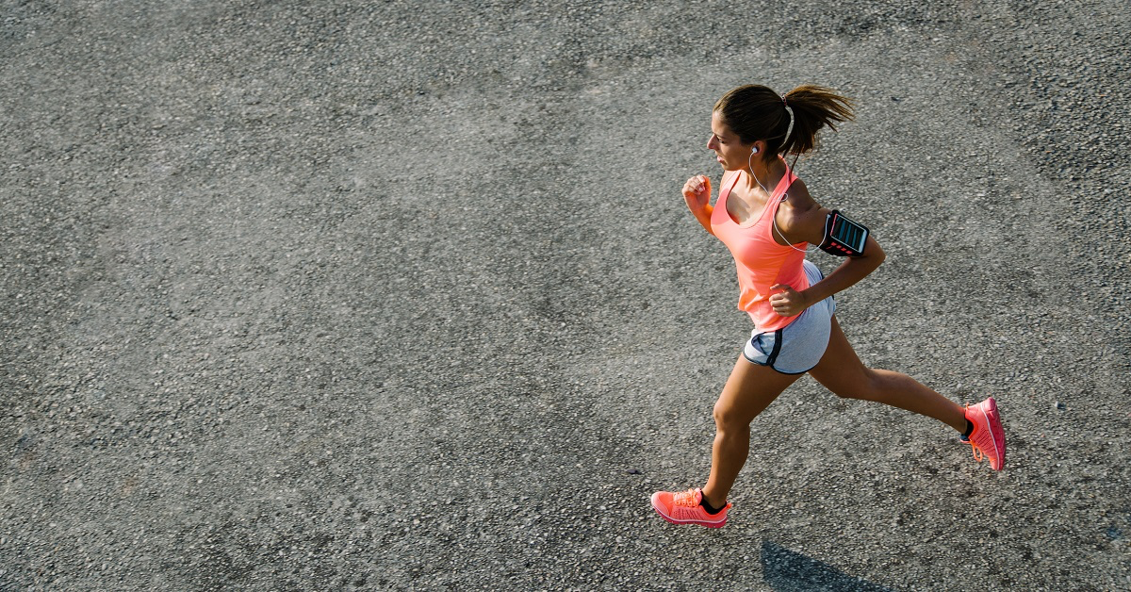
Exploring
Human Activity Recognition
Machine Learning Activity Classifier
Lakshmi Umarale, Srinivas Gogula, Shreya Suriya

Slide 2
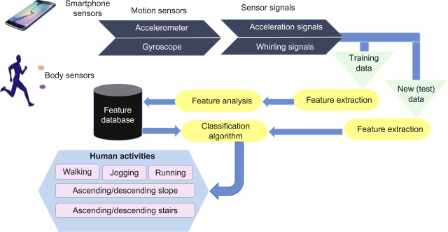
What is Human Activity Recognition (HAR)?
HAR is the problem of classifying sequences of accelerometer data recorded by specialized harnesses or smartphones into known well-defined movements.

Slide 3
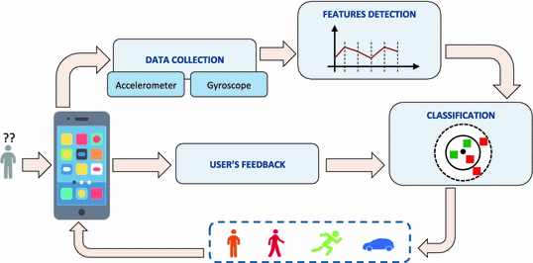
The Motivation + Purpose
Aim is to study various models and their accuracy to discover what would be best for the concept of HAR.
Purpose of this project is to dive deeper into the possibilities of Human Activity Recognition to see how accurately we will be able to identify and classify a range of different movements a human may perform into their respective classes.

Slide 4
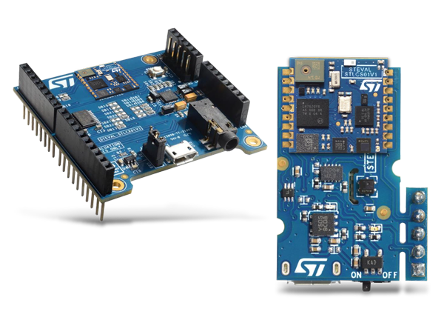

Materials
Hardware:
Software:
Data Collection:
SensorTile
Micro USB Cable
Power Bank
Communication and Sharing:
SmartPhone
Building Models:
Laptop
Data Collection:
STBLE App
Communication and Sharing:
Gmail
GitHub
Google Docs
Building Models:
Jupyter Notebook includes python libraries:
EdgeImpulse

Slide 5
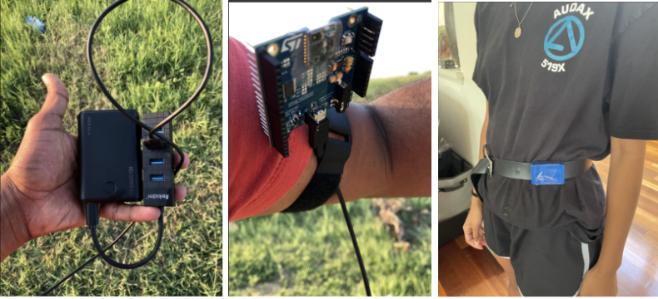
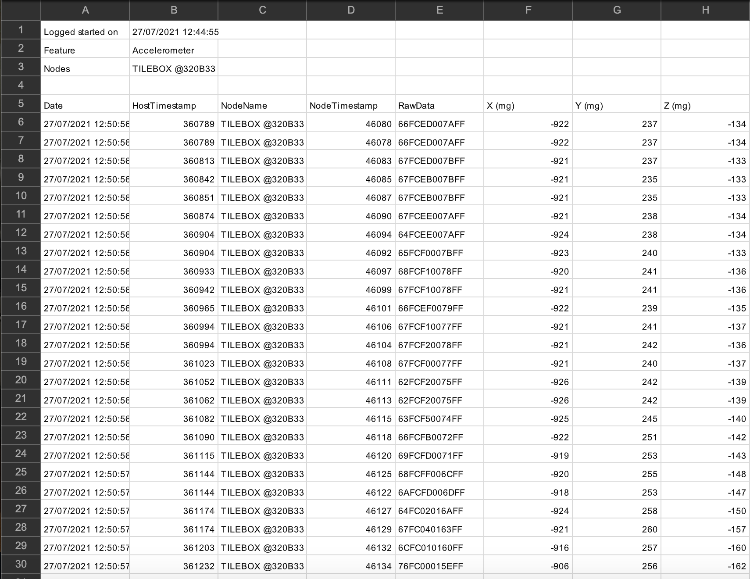
Data Acquisition
Used STM SensorTile Accelerometer to collect data.
Data was used to validate our model’s accuracy.
Logged our acceleration in the X, Y and Z axis using the STBLE App
Connected through Bluetooth to the SensorTile.
Sensortile was placed around the waist and secured with a belt, facing upwards to sense all ranges of motion.
Each activity was logged for sets of 40 seconds.
^Accelerometer Data Format

Slide 6
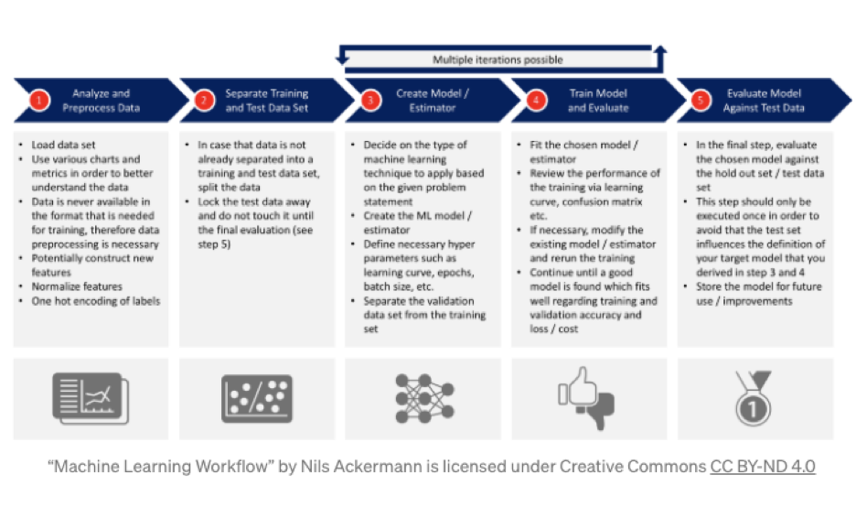
Modeling
Created 2 Models: Edge Impulse and Jupyter Notebook
Tested using data collected from SensorTile
< Steps for solving a Machine Learning Problem

Slide 7

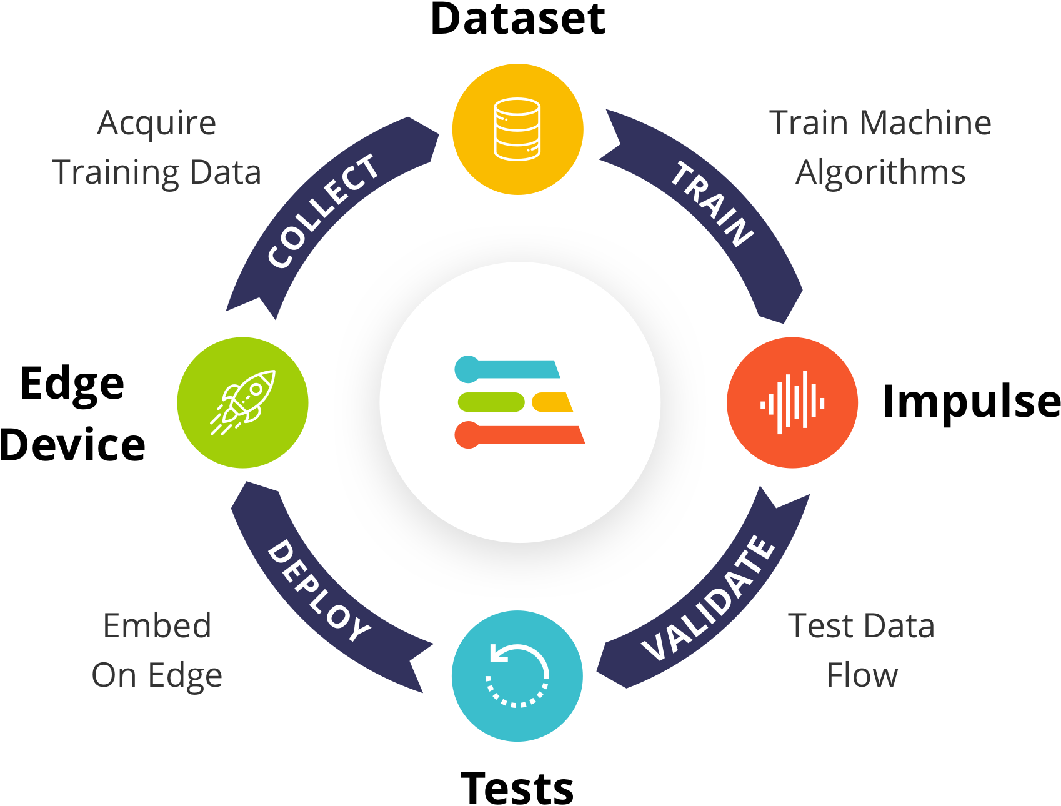
Modeling:
Edge Impulse Model
Edge Impulse: Using Edge Impulse, users can build a model in real-time using one’s phone’s accelerometer, microphone, or camera to collect data, train machine learning algorithms, and see what happens live on the platform.
WHAT WE”RE DOING:
Using this platform by importing the raw text data file from the WISDM dataset to the software and setting it as the model’s training data.
Creating the model using a neural network, or transfer learning, and test it with our Sensor Tile data to validate the performance.

Slide 8
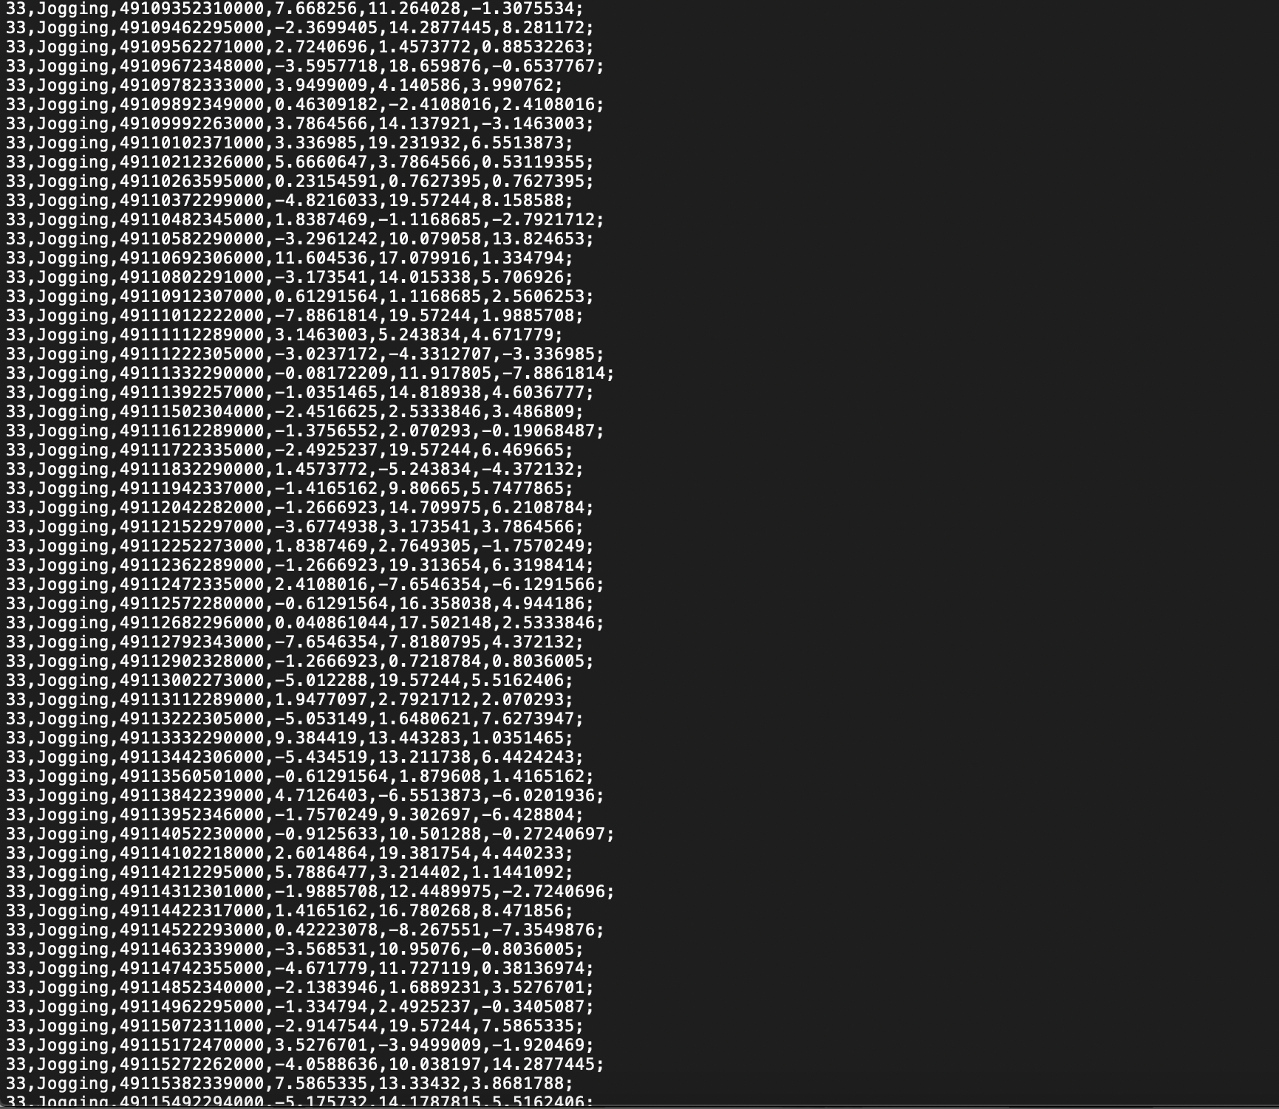
WISDM DataSet
Raw Time Series Data has 1,098,207 examples, with six attributes. Transformed Examples Data has 5,424 transformed examples and 46 transformed attributes.
We will be using the WISDM Dataset as our Training Data for each of our models.
6 LABELS:
Sitting
Standing
Walking
Jogging
Upstairs
Downstairs
← How the file looks, will be using this text file as the Training Data.
WISM_arv1.1_raw.txt

Slide 9
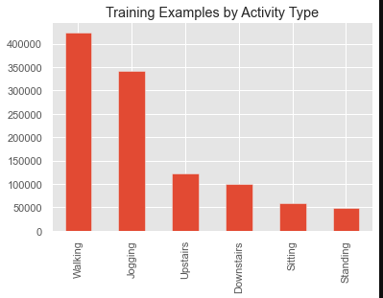
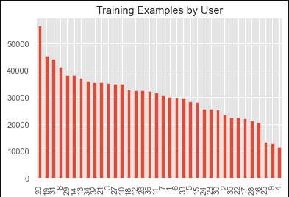
Exploratory Data Analysis

Slide 10
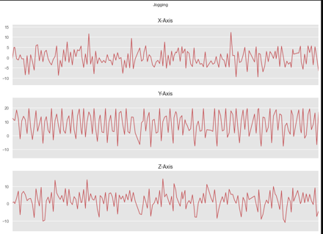
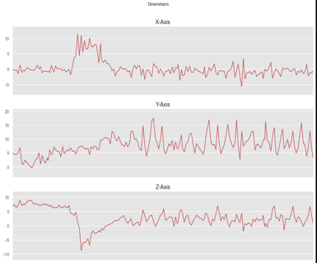
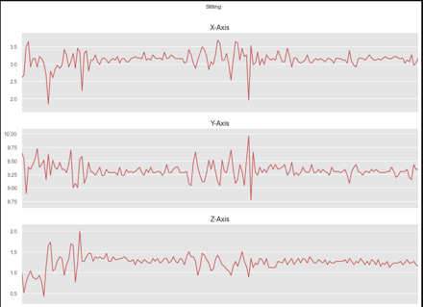
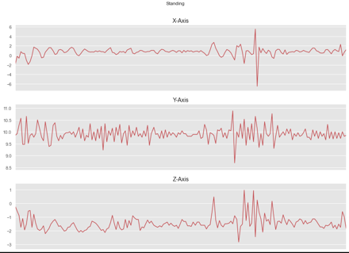
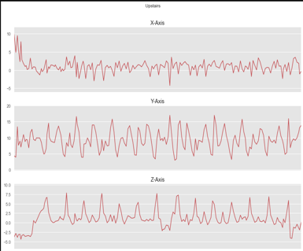
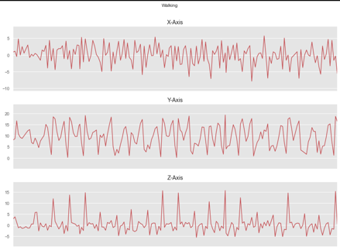
Visualization of Activities in X, Y and Z

Slide 11
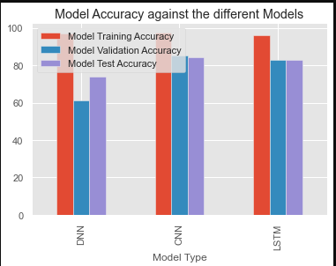
Model Accuracy
Models | Training Accuracy | Validation Accuracy | Test Accuracy
Deep Neural Network | 96.9% | 61.3% | 73.8%
Convolutional Neural Network | 97.6% | 85.1% | 84.5%
Long Short-Term Memory | 96.3% | 82.8% | 82.8%

Slide 12
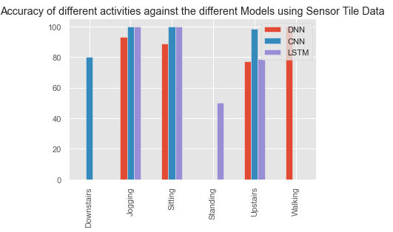
Model Accuracy using Sensor Tile Data

